Slide 1
Enterprise Programming using JAVA
Chapter-1: Foundation of Enterprise Programming
Prof. ARNIKA PATEL Assistant Professor
Department of CSE

Slide 2
Content
Introduction…………………………………….……… 1
JDBC Architecture………………………….…..……… 4
JDBC Components..…………………….…………….. 7
JDBC Classes and Interface……………….……….. 12
Key Features of JDBC.……………………............. 13
JDBC Drivers……………………………………………… 14
INDEX

Slide 3
JAVA DATABASE CONNECTIVITY (JDBC)
JDBC is an API that helps applications to communicate with databases, it allows Java programs to connect to a database, run queries, retrieve, and manipulate data

Slide 4
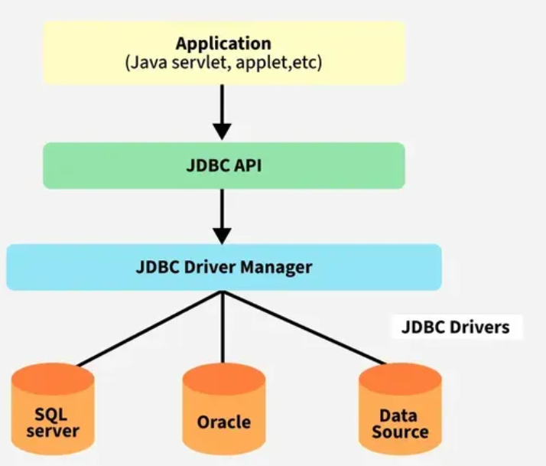
JDBC Architecture
Figure 1 JDBC Architecture

Slide 5
JDBC Architecture
Application
The JDBC API
DriverManager
JDBC drivers
The JDBC architecture consists of two-tier and three-tier processing models to access a database.

Slide 6
JDBC Architecture
Two-Tier Architecture
Client Application (Java) -> JDBC Driver -> Database
2. Three-Tier Architecture
Client Application -> Application Server -> JDBC Driver -> Database

Slide 7
JDBC Components
4 main components of JDBC
1. JDBC API
2. JDBC Driver Manager
3. JDBC Test Suite
4. JDBC Drivers

Slide 8
JDBC Components
1. JDBC API
It provides various methods and interfaces for easy communication with the database. It includes two key packages
java.sql: This package, is the part of Java Standard Edition (Java SE) , which contains the core interfaces and classes for accessing and processing data in relational databases.
javax.sql: This package is the part of Java Enterprise Edition (Java EE) , which extends the capabilities of java.sql by offering additional features like connection pooling, statement pooling, and data source management.

Slide 9
JDBC Components
2. JDBC Driver Manager
Driver manager is responsible for loading the correct database-specific driver to establish a connection with the database.

Slide 10
JDBC Components
3. JDBC Test Suit
It is used to test the operation(such as insertion, deletion, updating) being performed by JDBC Drivers.

Slide 11
JDBC Components
4. JDBC Drivers
JDBC drivers are client-side adapters (installed on the client machine, not on the server) that convert requests from Java programs to a protocol that the DBMS can understand.
There are 4 types of JDBC drivers:
Type-1 driver or JDBC-ODBC bridge driver
Type-2 driver or Native-API driver (partially java driver)
Type-3 driver or Network Protocol driver (fully java driver)
Type-4 driver or Thin driver (fully java driver) – It is a widely used driver. The older drivers like (JDBC-ODBC) bridge driver have been deprecated and no longer supported in modern versions of Java.

Slide 12
JDBC Classes and Interfaces
DriverManager: Manages JDBC drivers and establishes database connections.
Connection: Represents a session with a specific database.
Statement: Used to execute static SQL queries.
PreparedStatement: Precompiled SQL statement, used for dynamic queries with parameters.
CallableStatement: Used to execute stored procedures in the database.
ResultSet: Represents the result set of a query, allowing navigation through the rows.
SQLException: Handles SQL-related exceptions during database operations.

Slide 13
Key Features of JDBC
Platform Independence: JDBC can perform database operation on any platform
Standard API: It provides different ways to interact with different databases.
Support for Multiple Databases: JDBC provide support to work with different databases like MySQL, PostgreSQL, Oracle, etc.

Slide 14
JDBC Drivers
JDBC drivers are client-side adapters (installed on the client machine rather than the server) that translate requests from Java programs into a protocol understood by the DBMS.

Slide 15
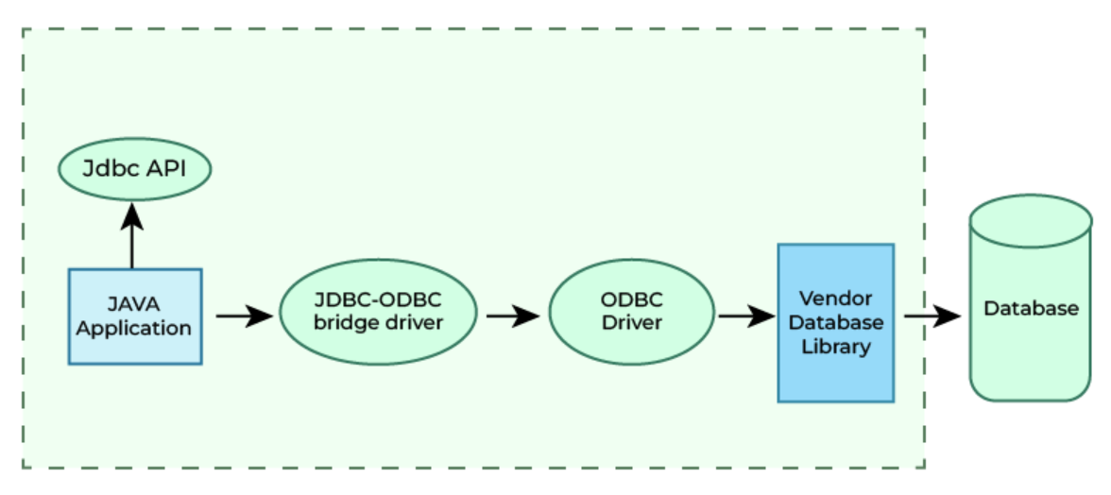
JDBC Drivers
JDBC-ODBC Bridge Driver – Type 1 Driver
Figure 2 Type-1 Driver

Slide 16
JDBC Drivers
JDBC-ODBC Bridge Driver – Type 1 Driver
Type-1 driver or JDBC-ODBC bridge driver uses ODBC driver to connect to the database.
The JDBC-ODBC bridge driver converts JDBC method calls into the ODBC function calls.
Type-1 driver is also called Universal driver because it can be used to connect to any of the databases.

Slide 17
JDBC Drivers
JDBC-ODBC Bridge Driver – Type 1 Driver
Advantages
This driver software is built-in with JDK so no need to install separately.
It is a database independent driver.
Disadvantages
As a common driver is used in order to interact with different databases, the data transferred through this driver is not so secured.
The ODBC bridge driver is needed to be installed in individual client machines.
Type-1 driver isn’t written in java, that’s why it isn’t a portable driver.

Slide 18
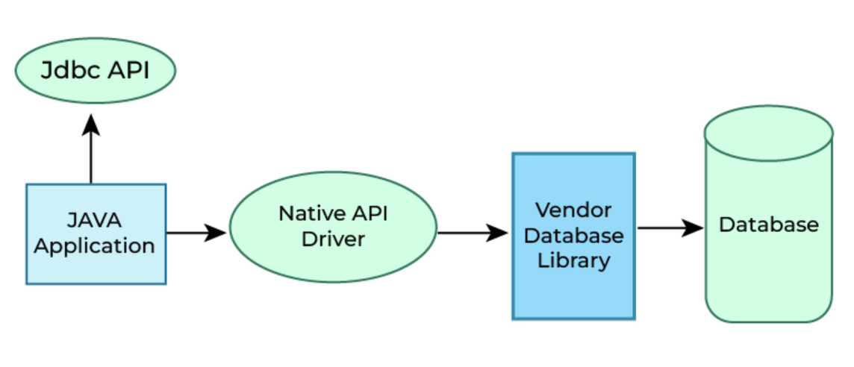
JDBC Drivers
2. Native-API Driver – Type 2 Driver ( Partially Java Driver)
Figure 3 Type-2 Driver

Slide 19
JDBC Drivers
Native-API Driver – Type 2 Driver ( Partially Java Driver)
The Native API driver uses the client -side libraries of the database.
This driver converts JDBC method calls into native calls of the database API.
In order to interact with different database, this driver needs their local API, that’s why data transfer is much more secure as compared to type-1 driver.
This driver is not fully written in Java that is why it is also called Partially Java driver.

Slide 20
JDBC Drivers
Native-API Driver – Type 2 Driver ( Partially Java Driver)
Advantages
Native-API driver gives better performance than JDBC-ODBC bridge driver.
More secure compared to the type-1 driver.
Disadvantages
Driver needs to be installed separately in individual client machines
The Vendor client library needs to be installed on client machine.
Type-2 driver isn’t written in java, that’s why it isn’t a portable driver
It is a database dependent driver.

Slide 21
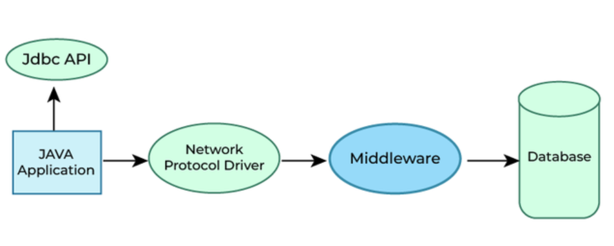
JDBC Drivers
3. Network Protocol Driver – Type 3 Driver (Fully Java Driver)
Figure 4 Type-3 Driver

Slide 22
JDBC Drivers
3. Network Protocol Driver – Type 3 Driver (Fully Java Driver)
The Network Protocol driver uses middleware (application server) that converts JDBC calls directly or indirectly into the vendor-specific database protocol.
Here all the database connectivity drivers are present in a single server, hence no need of individual client-side installation.

Slide 23
JDBC Drivers
3. Network Protocol Driver – Type 3 Driver (Fully Java Driver)
Advantages
Type-3 drivers are fully written in Java, hence they are portable drivers.
No client side library is required because of application server that can perform many tasks like auditing, load balancing, logging etc.
Switch facility to switch over from one database to another database.

Slide 24
JDBC Drivers
3. Network Protocol Driver – Type 3 Driver (Fully Java Driver)
Disadvantages
Network support is required on client machine.
Maintenance of Network Protocol driver becomes costly because it requires database-specific coding to be done in the middle tier.

Slide 25
JDBC Drivers
3. Thin Driver – Type 4 Driver (Fully Java Driver)
Type-4 driver is also called native protocol driver. This driver interact directly with database. It does not require any native database library, that is why it is also known as Thin Driver.

Slide 26
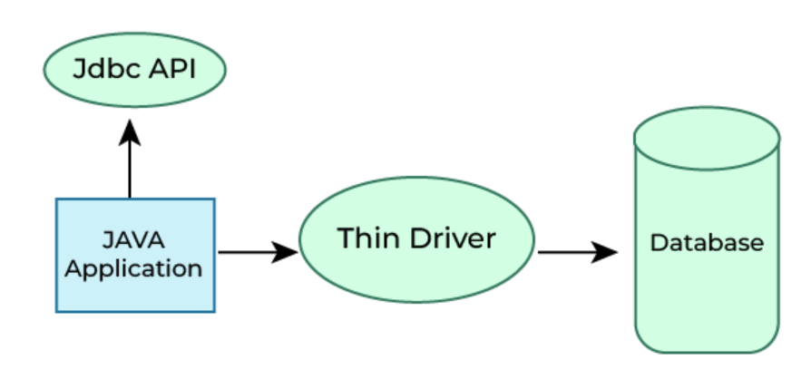
JDBC Drivers
3. Thin Driver – Type 4 Driver (Fully Java Driver)
Figure 5 Type-4 Driver

Slide 27
JDBC Drivers
3. Thin Driver – Type 4 Driver (Fully Java Driver)
Advantages
Does not require any native library and Middleware server, so no client-side or server-side installation.
It is fully written in Java language, hence they are portable drivers.
Disadvantage
If the database changes, a new driver may be needed.

Slide 28
JDBC Drivers
Which Driver to use When?
If you are accessing one type of database, such as Oracle, Sybase, or IBM, the preferred driver type is type-4.
If your Java application is accessing multiple types of databases at the same time, type 3 is the preferred driver.
Type 2 drivers are useful in situations, where a type 3 or type 4 driver is not available yet for your database.
The type 1 driver is not considered a deployment-level driver, and is typically used for development and testing purposes only

Slide 29
PPT Content Resources Reference Sample:
Book Reference Jim Farley, William Crawford, David Flanagan. Java Enterprise in a Nutshell, O'Reilly
Book Reference
Rocha, R., Purificação, J. (2018). Java EE 8 Design Patterns and Best Practices: Build Enterprise-ready Scalable Applications with Architectural Design Patterns. Germany: Packt Publishing..
Website Reference
https://www.scribd.com/document/268349254/Java-8-Programming-Black-Book .
Sources
https://developers.redhat.com/topics/enterprise-java
Article
https://www.researchgate.net/publication/276412369_Advanced_Java_Programming

